Slide 1
Voices in Transition: Arrival Stories from Columbus, Ohio Then and Now
We begin with the tree of life. It invites us to explore the humanity and values that are present within all of the cultures that makeup Ohio’s communities. The tree of life can be found throughout the text set in that it symbolizes:
Individual growth, strength and uniqueness
Family Roots represents family and ancestral roots. Just as the tree is rooted and branches out, a family is rooted in its history and branches out, creating new life. The interconnected network of roots and branches represents the continuity and network of families across generations.
Rebirth and Immortality as it shows a fresh start on life which is full of positive energy and potential and that even as it ages, it lives on through the new saplings growing from its seeds.
Being Grounded in that you are grounded, rooted, and connected to the world around you.
Connection in that there is a connection to everything, similar to how a tree is connected to the soil, the air, the sun, and the surrounding area,

Slide 2
Voices in Transition: Arrival Stories from Columbus, Ohio Then and Now
Overview of the Text Set:
The intention of this text set is to highlight the common threads of humanity that are found among the groups that have migrated or immigrated to Columbus, Ohio. The resources speak to the historical as well as present day push and pull factors that have spurred groups of people to come to Ohio. The literature was intentionally selected to provide mirrors for a diverse population of learners but also to act as windows for the developments of empathy and understanding for groups that are different than themselves. The literature is presented within a context of the immigrant narrative and through the lens of the cultural enclaves that established communities and neighborhoods in Columbus. The historical primary and secondary resources depict the agency of community members to problem solve and the value that was placed on the continuation of cultural practices. The literature as well as the resources were selected in that they embodied the importance of people’s ability to share their own stories in their own voice.
Guiding Inquiry Questions
Q: How can we use timelines to show the movement of people within the different communities and explain the cause and effects of events that promote change within those communities.
Q: How do different sources help us understand how communities continue to change over time and how primary sources such as oral histories provide a humanistic perspective.
Q: What evidence can we identify to describe changes in our communities and how are these changes specifically tied to who is living in those communities?
Q: What factors affect who lives in a specific community and what cultural practices are promoted by the people living in the community?
Q: How do groups or individuals advocate for themselves in order to make their lives better?
Based on the Ohio’s Learning Standards for Social Studies

Slide 3
Resources for Understanding Migration and Immigration in Ohio
If we could look into each other’s heart and understand the unique challenges each of us faces, I think we could treat each other much more gently, with more love, patience, tolerance and care.
- Marvin Ashton
This set of resources provides trends and data and a historical context for immigration in Columbus and Ohio as whole. There are a variety of resources including maps, videos and infographics.
Why do immigrants matter to Ohio? Click on the infographics to find out.

Slide 4
For more short stories...

Slide 5
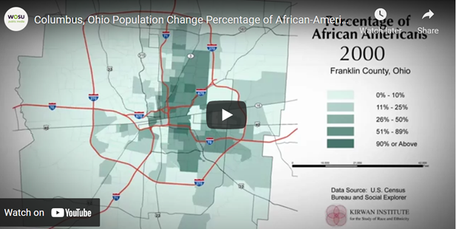
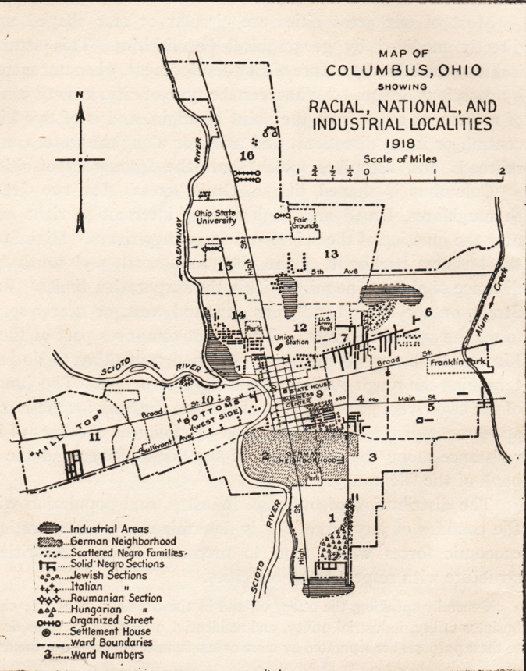
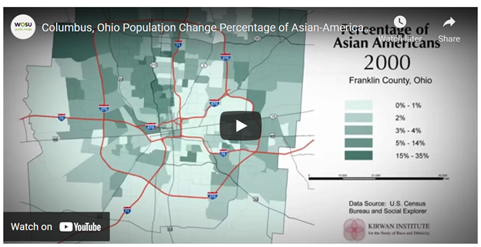
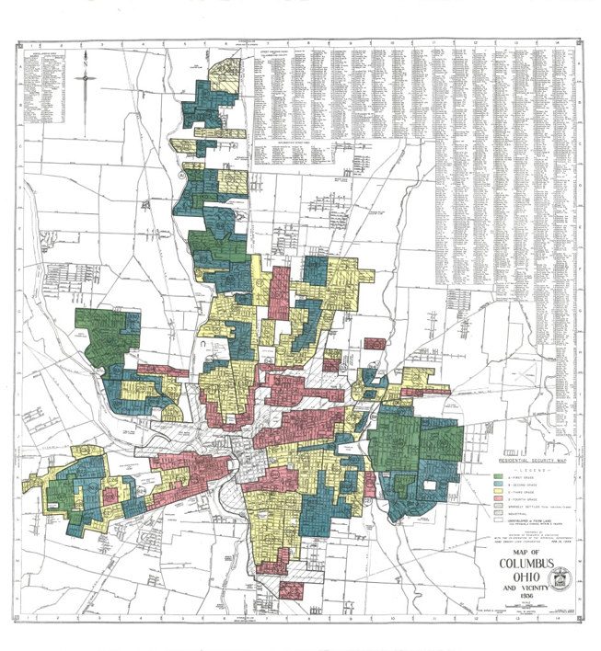
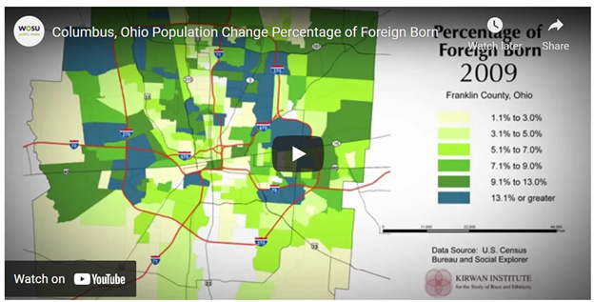
Columbus Then...
Columbus Now...
1980-2010
Home Owners’ Loan Corporation 1935 residential security map of Columbus

Slide 6
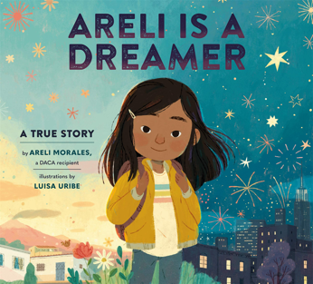
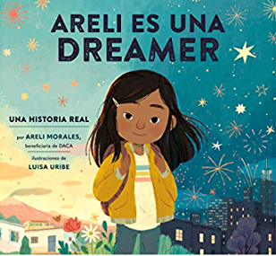
Featured Voices from the Latinx Community
We need to help students and parents cherish and preserve the ethnic and cultural diversity that nourishes and strengthens this community- and this nation. -Cesar Chavez
This group of illustrated texts depict the latinx experience beyond the immigrant narrative in that it also portrays aspects of family and community life. The resources were specifically selected because the author and/or illustrator are speaking in their own voice about their experiences. This is something that was considered for all text selections. The links are provided for read aloud and additional resources and the descriptions are from goodreads.com.
When Areli was just a baby, her mama and papa moved from Mexico to New York with her brother, Alex, and when she was in kindergarten, they sent for her, too.
This story resonates with millions of immigrants--about one girl living in two worlds, a girl whose DACA application was eventually approved and who is now living her American dream.
Areli is a Dreamer Read Aloud

Slide 7
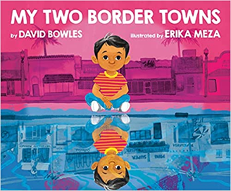
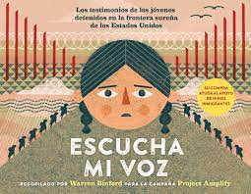
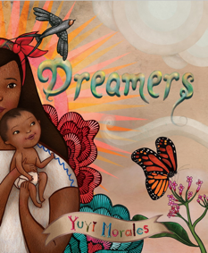
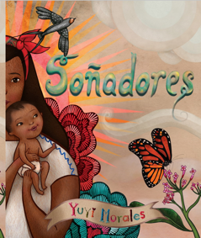
My Two Border Towns by David Bowles, with illustrations by Erika Meza, is the loving story of a father and son's weekend ritual, a demonstration of community care, and a tribute to the fluidity, complexity, and vibrancy of life on the U.S.-Mexico border.
A moving picture book that amplifies the voices and experiences of immigrant children detained at the border between Mexico and the US. The children's actual words (from publicly available court documents) are assembled in both English and Spanish. Each spread is illustrated by a different Latinx artist.
Hear My Voice by Warren Binford
Yuyi Morales tells her own immigration story. In 1994, Yuyi Morales left her home in Xalapa, Mexico and came to the US with her infant son.
She brought her strength, her work, her passion, her hopes and dreams...and her stories.
Dreamers by yuyi morales
Dreamers Video

Slide 8
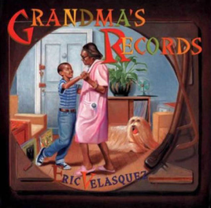
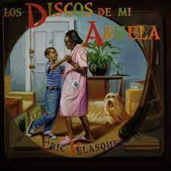
This book is an opportunity to hear directly from youth who are often in the headlines but whose stories don't get told in full. Sixteen young people from the Latin American Youth Center (LAYC) in Washington, D.C. came together to tell their own stories of immigration and transformation in comics form. The result is this side-by-side bilingual collection of graphic memoirs that not only builds connections across language, but also breaks down barriers and expands hope.
SPX 2018 Panel - Teen Latinx Memoir
When Carmela wakes up on her birthday, her wish has already come true--she's finally old enough to join her big brother as he does the family errands. Together, they travel through their neighborhood until they arrive at the Laundromat, where Carmela finds a lone dandelion growing in the pavement. But before she can blow its white fluff away, her brother tells her she has to make a wish. If only she can think of just the right wish to make . . .
Carmela Full of Wishes
Matt de la la Peña and Christian Robinson on CARMELA FULL OF WISHES
Every summer, Eric goes to live with his grandmother in El Barrio (Spanish Harlem) while his parents work. Through the long hot days, Grandma fills her apartment with the blaring horns and conga drums of Bomba y Plena, salsa, and merengue-the music she grew up with in Puerto Rico-sharing her memories and passions with Eric.
Join Eric Velasquez on a magical journey through time and across cultures, as a young boy's passion for music and art is forged by a powerful bond between generations.
Grandma’s Records Read Aloud

Slide 9
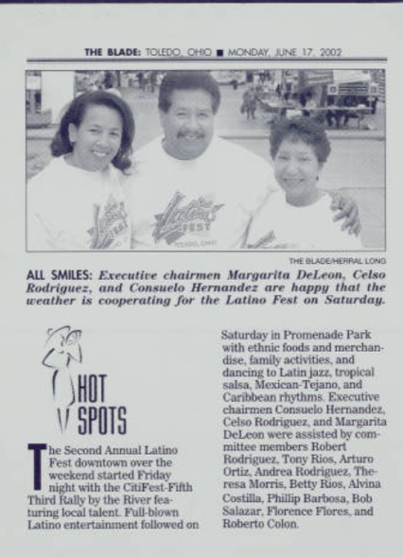
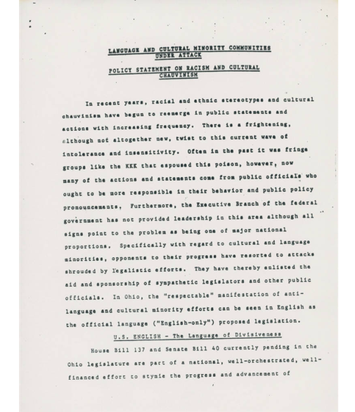
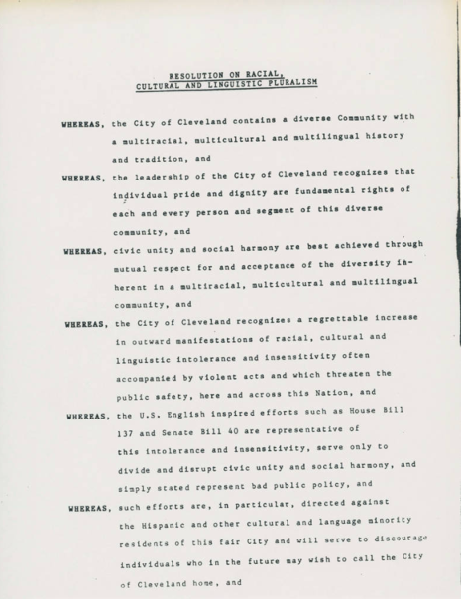
When Daisy Ramona zooms around her neighborhood with her papi on his motorcycle, she sees the people and places she's always known. She also sees a community that is rapidly changing around her.
But as the sun sets purple-blue-gold behind Daisy Ramona and her papi, she knows that the love she feels will always be there.
Isabel Quintero reads My Papi Has a Motorcycle at the Texas Book Festival
Additional Resources about the Latinx Experience in Ohio
This document is titled ""Language and Cultural Minority Communities Under Attack; Policy Statement on Racism and Cultural Chauvinism." It is a series of resolutions expressing opposition to Ohio's House Bill 137 and Senate Bill 40, by National IMAGE, IMAGE of Northeast Ohio, and IMAGE of New Mexico. (left)
This document,"Resolutions on Racial, Cultural and Linguistic Pluralism," was written by The City of Cleveland in opposition to Ohio's House Bill 137 and Senate Bill 40. Among the reasons for opposing the bills is the city's desire to maintain civic unity and social harmony through mutual respect of the diversity inherent in a multiracial, multicultural and multilingual community. (right)

Slide 10
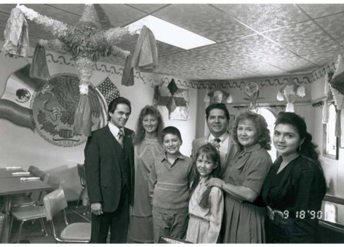
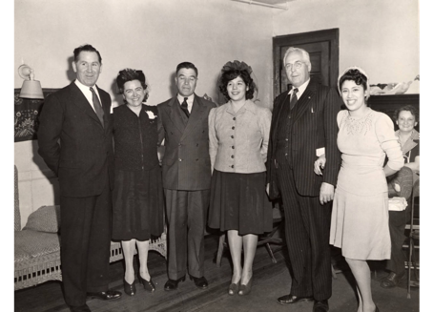
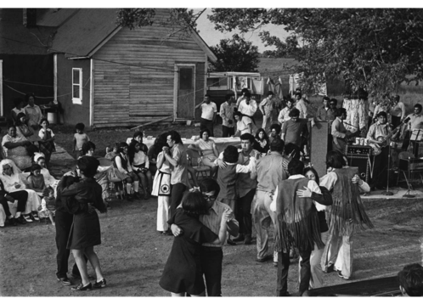
Links are provided via underlined titles.
Margarita De Leon Latino Community Collection- found in the Toledo Lucas County Public Library digital collections and includes photos and documents of daily life, events and advocacy for community needs.
Ohio Hispanics- Report prepared by the Ohio Department of development
City Club Of Cleveland- Raul Yzaguirre, president: National Council of Las Raza, NCLR, a civil rights advocacy organization for Hispanic Americans.
Hispanic Chamber of Columbus- It is important to see that many of these cultural groups have formed organizations that allow them to communicate among themselves, with other member of the community and with local governments in order to advocate for themselves.
La Villa Hispana
The Mexican Cultural Society committee; Mr. Jeffrey Goodson (?) membership chairman; and Ernst (?) Hockstetter, treasurer, pose for a photograph at the International Institute of Toledo, Ohio, on November 8, 1943.
A family poses for a portrait inside the El Tipico Mexican restaurant on South Avenue in Toledo,
Photograph of Mexican-Americans at a wedding in Curtice, Ohio. The photo dates around 1970.

Slide 11
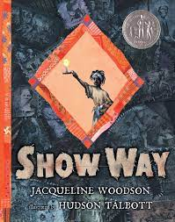
Featured Voices from the African American Community
We all should know that diversity makes for a rich tapestry and we must understand that all the threads of the tapestry are equal in value no matter their color. - Maya Angelou
This literature speaks to the African American experience beyond the lens of slavery,the great migration and the civil rights movement. The resources were selected because they speak to the identity and agency that the community embodies in establishing their own settlements and the intentional transmission of cultural practices.
From slavery to freedom, through segregation, freedom marches and the fight for literacy, the tradition they called Show Way has been passed down by the women in Jacqueline Woodson's family as a way to remember the past and celebrate the possibilities of the future. Beautifully rendered in Hudson Talbott's luminous art, this moving, lyrical account pays tribute to women whose strength and knowledge illuminate their daughters' lives.
"Show Way" by Jacqueline Woodson
Jacqueline Woodson

Slide 12
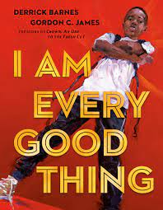
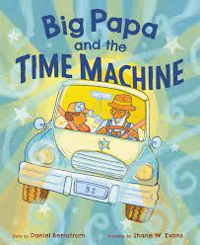
The confident Black narrator of this book is proud of everything that makes him who he is. He's got big plans, and no doubt he'll see them through--as he's creative, adventurous, smart, funny, and a good friend. Sometimes he falls, but he always gets back up. And other times he's afraid, because he's so often misunderstood and called what he is not. So slow down and really look and listen, when somebody tells you--and shows you--who they are. There are superheroes in our midst!
I Am Every Good Thing (Literally Cultured Read Aloud)
Derrick Barnes | I Am Every Good Thing
A little boy who lives with his grandpa isn’t reprimanded for being afraid to go to school one day. Instead, Big Papa takes him away in his time machine—a 1952 Ford—back to all of the times when he, himself, was scared of something life was handing him.
Big Papa and the Time Machine speaks to the African American experience in a touching dialogue between two family members from different generations, and emerges as a voice that shares history and asks questions about one family’s experience in 20th-century black America.
"Big Papa & The Time Machine" by Daniel Bernstrom - 2020 MN Children's Book Festival
A collection of poems to inspire kids to stay woke and become a new generation of activists. Historically poets have been on the forefront of social movements. Woke is a collection of poems by women that reflects the joy and passion in the fight for social justice, tackling topics from discrimination to empathy, and acceptance to speaking out.
Woke: A Young Poet's Call to Justice (Literally Cultured Read Aloud)
Mahogany L. Browne and Jason Reynolds on Woke: A Young Poet's Call to Justice
Mahogany L. Browne reads from 'Woke: A Young Poet's Call to Justice'

Slide 13
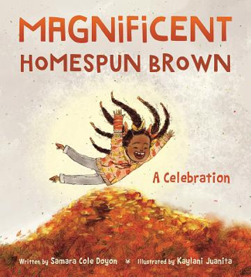
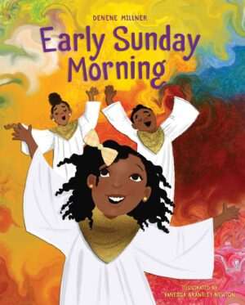
If Walt Whitman were reborn as a vibrant young woman of color, this is the book he might write. America, we hear you singing! With vivid illustrations by Kaylani Juanita, Samara Cole Doyon sings a carol for the plenitude that surrounds us and the self each of us is meant to inhabit.
"Magnificent Homespun Brown" Reading
A child reflects on the meaning of being Black in this moving and powerful anthem about a people, a culture, a history, and a legacy that lives on. From the wheels of a bicycle to the robe on Thurgood Marshall's back, Black surrounds our lives. It is a color to simply describe some of our favorite things, but it also evokes a deeper sentiment about the incredible people who helped change the world and a community that continues to grow and thrive.
OurShelves: Black is a Rainbow Color
Early Sunday Morning is a heartwarming celebration of the special time a young girl and her family share together as she learns how to lift her mighty voice.
Love and family. These are the things that a little girl finds most special about Sunday mornings. Early Sunday Morning follows June, Mommy, Daddy, and brother Troy through their weekend routine as June prepares for a special performance leading the children’s choir at church on Sunday morning.
Early Sunday Morning Read-Aloud with Author Denene Millner | Read & Learn with Simon Kids

Slide 14
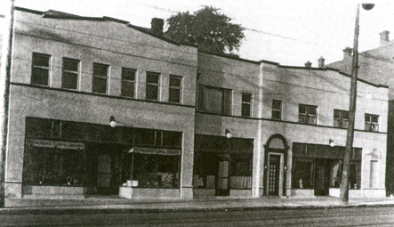
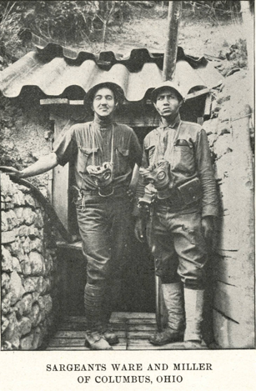
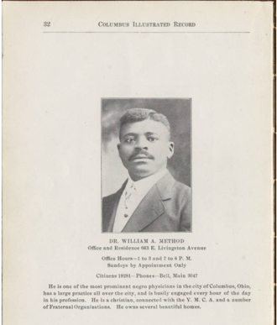
Additional Resources about the African American Experience in Ohio
African-American Settlements and Communities in Columbus, Ohio- A record of settlements and community life with documents, illustrations and detailed information by the Columbus Landmark Foundation. African Americans in Ohio- Several historical collections of African American experiences in Ohio
Browse Items · Teaching Columbus Historic Places
A page from the Columbus Illustrated record of Dr William Method. For more information https://ohiomemory.ohiohistory.org/archives/1545
To see the record click in the image
Alpha Hospital and Professional Building was built in 1920. Located on the corner of 17th and Long Street, this hospital was established by Dr. William Method and Dr. R. M. Tribbitt for the African-American community. It cost $23,000 to erect and functioned as a private institution.
Mess Sergeant Henry H. Ware (9/17/1897-11/25/1963) and Sergeant Wyatt Miller (1/28/1896-10/21/1960) served in Company B, 9th Training Battalion Infantry, 62 Depot Brigade, 37th Division, of the United States Army during World War I.

Slide 15
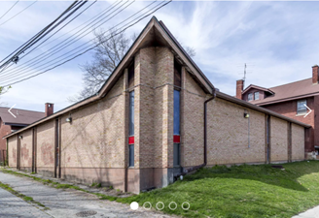
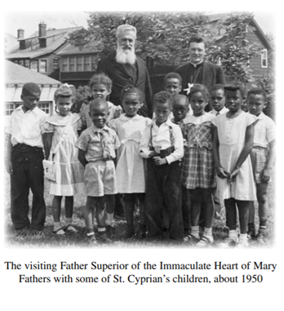
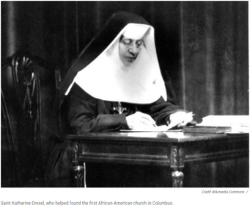
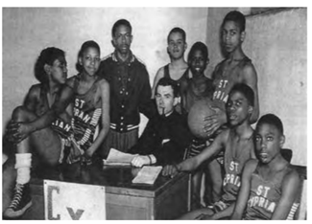
"You can bulldoze our histories but you cannot take away our stories."- Patricia Preciado Martin
2021 Most Endangered Sites
Click on the above images to learn more.
In 1957, urban resettlement forced St. Cyprian to close. Irish Catholics left St. Dominic’s when the Pennsylvania Railroad closed. Bishop Michael Ready combined the two parishes, sending the African-American community to St. Dominic’s.
The basketball team was the pride of St, Cyprian’s Roman Catholic Church, circa 1940’s

Slide 16
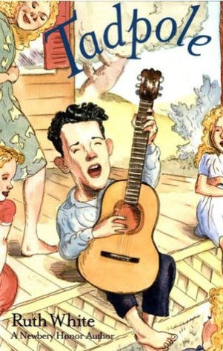
Featured Voices from the Appalachian Community
I would never have started this trip if I had known how tough it was, but I couldn’t and wouldn’t quit-Grandma Gatewood
This collection of illustrated texts is intended to share Appalachian culture that is often stereotyped or lives hidden among other members of the communities in Columbus.The narratives and resources focus on family and a way of life and thinking the began in the 1700s when immigrants from the British Isles and Germany arrived in valley and ridge country of Virginia and North Carolina. Appalachian culture is intertwined with the indigenous people that first inhabited the area.
A funny and moving story set in Kentucky
It’s the beginning of summer 1955 and each of her older sisters seems to have cut out a niche for herself, but Carolina Collins is still trying to find her own special place in life. The girls’ hardship is softened by the sudden appearance of their favorite cousin, Tadpole. The Collinses soon learn the real reason for Tad’s visit, however, and the weeks that follow are filled with dread that his abusive guardian will come and take him away. But Tad is not the sort of boy to succumb to a bully, and he and Carolina both have surprises store for everyone.

Slide 17
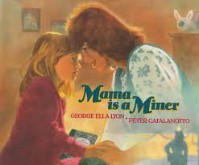
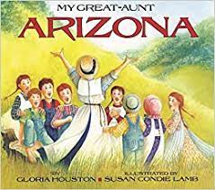
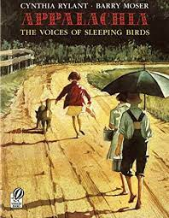
Author and artist researched this book together in a coal mine in Harlan County, Kentucky. Like Mamma, they rode the mantrip and hiked to the working face, climbing through windows from passage to passage and experiencing the loss of light.
Based on a true story, author Gloria Houston's joyous recounting of her great-aunt Arizona's quiet yet meaningful life.
Arizona was born in a log cabin her papa built in the Blue Ridge Mountains. Arizona never did make it to those places. Instead she became a teacher, helping generations of children in the one-room schoolhouse which she herself had attended.
My Great Aunt Arizona
Lyrical prose and warm watercolor illustrations bring a "certain part of the country called Appalachia" alive for young readers. Two award-winning artists, forever touched by their experiences growing up in this unique landscape, have teamed to create a quietly powerful and beautifully crafted portrait of life in a timeless place.
Appalachia: The Voices Of Sleeping Birds

Slide 18
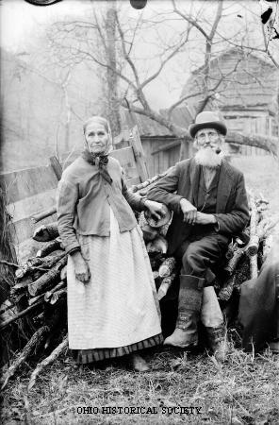
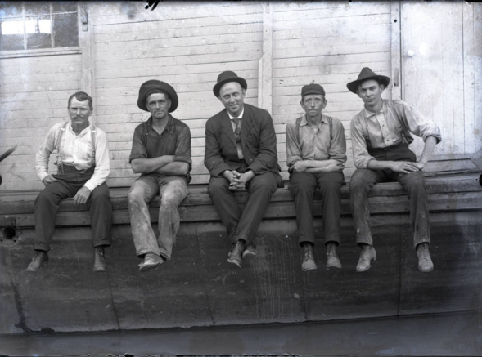
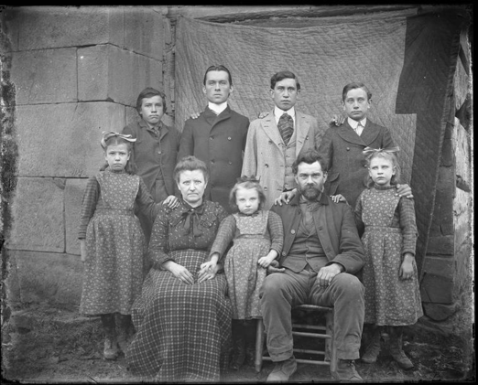
Additional Resources about the Appalachian Experience in Ohio
The Picture Man- Julia Taylor Ebel
"Our Stories Are Important Stories": George Ella Lyon-this interview with author George Ella Lyon is an audio-visual component included in the exhibition "Reading Appalachia: Voices from Children's Literature" on view at the Museum of East Tennessee
Get to Know Jesse Jackson, Children's Author | Special Collections Research Center
https://u.osu.edu/asn/- Appalachian Studies Network
https://ohiohistorycentral.org/w/Appalachia- From Ohio History Central information about appalachian community in Ohio
Photographs from the Albert J. Ewing Collection 1890-1912
https://www.ohiomemory.org/digital/collection/p16007coll19/search/page/1/collection/p16007coll19

Slide 19
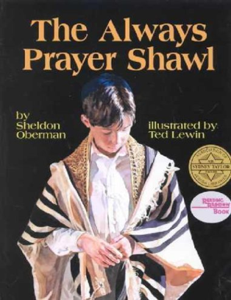
Featured Voices from the Jewish Community
We must not only learn to tolerate our differences. We must welcome them as the richness and diversity which can lead to true intelligence. - Albert Einstein
These illustrated texts and resources highlight the diverse jewish experiences from immigration to family to traditions. Much of the resources depict daily experiences, elders in the community and the importance of identity and social organizations.
"Some things change. And some things don't."
That simple truth, whispered in a synagogue, echoes throughout this deeply felt picture book. Adam, a young Jewish boy in czarist Russia, must flee his ancestral home at the outbreak of the revolution. Before he sets sail for a new land, his grandfather gives him a prayer shawl that was handed to him by his own grandfather, who was also named Adam. And so the life of Adam and his prayer shawl unfolds from time past to time present, when Adam has a grandson of his own.

Slide 20
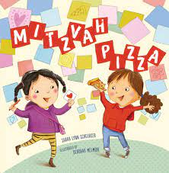
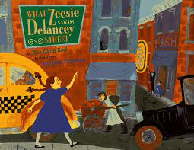
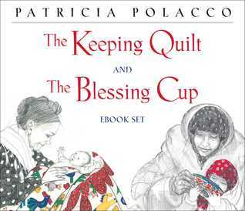
Missy loves Saturdays with her dad. Every week they do something special together. Usually, Dad brings the funds and Missy brings the fun, but this week, it's Missy's turn to treat with her own allowance--until she and her dad stop for pizza, and Missy discovers a special way to do a mitzvah.
Mitzvah Pizza
Zeesie feels very grown-up indeed! Zeesie is going to her first package party with Mama and Papa. The package party is grand, with great towers of wrapped surprise packages to be auctioned to raise money for other new immigrants to the community. But as Zeesie soon discovers, not everything and everyplace is meant to be explored, and what she does see that night on Delancey Street leaves her with a new knowledge about giving and receiving.
The Keeping Quilt
And so it was. From a basket of old clothes, Anna’s babushka, Uncle Vladimir’s shirt, Aunt Havalah’s nightdress, and an apron of Aunt Natasha’s become the keeping quilt. Patricia Polacco tells the story of her own family and the quilt’s further story that remains a symbol of their enduring love and faith. This anniversary edition includes fifteen pages of original material describing the quilt’s journey and its home at the Mazza Museum in Findley, Ohio.
The Blessing Cup
As a young Russian Jewish girl in the early 1900s, Anna and her family lived in fear of the Czar’s soldiers. The family lived a hard life and had few possessions—their treasure was a beautiful china tea set. When Anna’s family leaves Russia for America, they bring the tea set and its blessings. A source of heritage and security, the tea set helps Anna’s family make friends and find better lives in America.
The Keeping Quilt
Patricia Polacco, The Keeping Quilt
Patricia Polacco Shows The Keeping Quilt
Blessing Cup

Slide 21
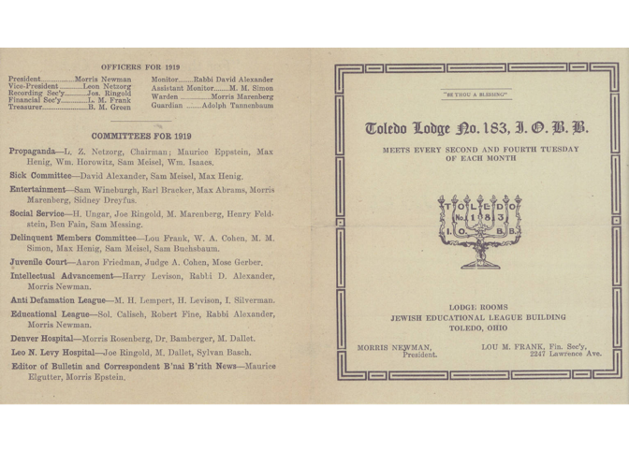
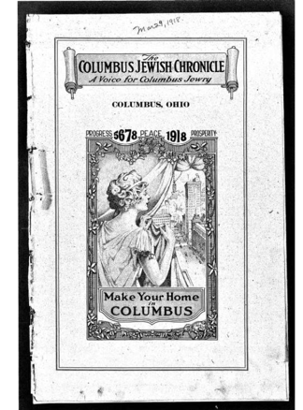
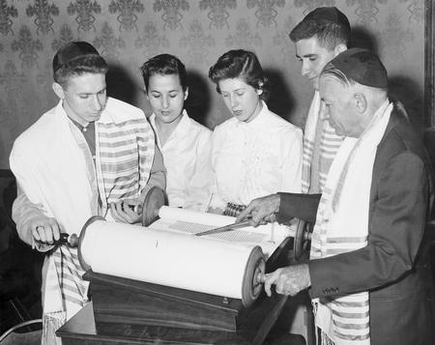
Additional Resources about the Jewish Experience in Ohio
Toledo Area Jewish History Project- A collection of photographs and documents depicting daily life from the Toledo Lucas County Public Library Digital Collections
Jewish Ohioans- From Ohio History Central information about Jewish community in Ohio
http://library.cincymuseum.org/journals/files/chsbull/v30/n3-4/chsbull-v30-n3-4-ori-154.pdf- The Origins of the Jewish Community of Cincinnati
A 1919 document from Lodge 183 of the Social Enrichment Jewish Organization shows the deep level of commitment of the Toledo Jewish community to social justice after the close of World War I.
The history of the Columbus Jewish community as recorded weekly from its beginning in 1922 through 1994. Click on the image for link
Rabbi Harry Kaplan leading Jewish students who were members of the B' Nai B' Rith Hillel Foundation at Ohio State University in a religious service, ca. 1940-1960.

Slide 22
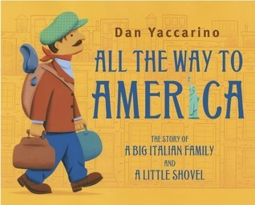
Featured Voices from the European Community
Migration is an expression of the human aspiration for dignity, safety and a better future. It is part of the social fabric, part of our very make-up as a human family. -Ban Ki-moon
One of the biggest challenges in depicting European immigration is not describing it only in the past tense as many immigrants continue to come from Europe for many of the same reasons that their predecessors came. This collection however does focus on the waves of immigrants that came to Ohio and established cultural enclaves, held on their languages and traditions and often replaced each other in response to economic and sociological factors.
Dan Yaccarino’s great-grandfather arrived at Ellis Island with a small shovel and his parents’ good advice: “Work hard, but remember to enjoy life, and never forget your family.” Yaccarino recounts how the little shovel was passed down through four generations of this Italian-American family—along with the good advice.
“All The Way To America” Read By Dan Yaccarino | Kids Books Read Aloud With Gotham Reads

Slide 23
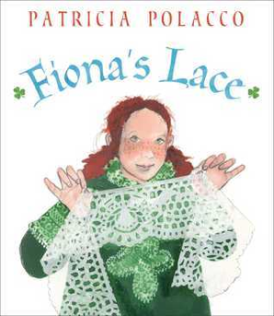
When Clara Lemlich arrived in America, she couldn't speak English. She didn't know that young women had to go to work, that they traded an education for long hours of labor, that she was expected to grow up fast.
Clara never quit. She went to night school, spent hours studying English, and helped support her family by sewing in a factory. And she never accepted that girls should be treated poorly and paid little. She learned that everyone deserved a fair chance. That you had to stand together and fight for what you wanted. And, most importantly, that you could do anything you put your mind to.
Brave Girl: Clara and the Shirtwaist Makers’ Strike of 1909 (Literally Cultured Read Aloud)
This generational story comes from the family of Patricia Polacco’s Irish father. Fiona and her family travel from Ireland to Chicago. They find work in domestic service to pay back their passage, and at night Fiona turns tangles of thread into a fine, glorious lace. Then when the family is separated, it is the lace that Fiona’s parents follow to find her and her sister and bring the family back together.
Kids Book Read Aloud: Fiona's Lace by Patricia Polacco
A little girl and her favorite dress dream of an extraordinary life. They enjoy simple pleasures together on a beautiful Greek island. One day, the dress and the girl must leave the island and immigrate to the United States. Upon arrival, the girl is separated from the trunk carrying her favorite dress, and she fears her dress is lost forever. Many years later, the girl—now all grown up—spots the dress in a thrift store window. As the two are finally reunited, the memories of their times together come flooding back. While the girl can no longer wear the dress, it’s now perfect for her own daughter.
The Dress and the Girl read aloud picture book

Slide 24
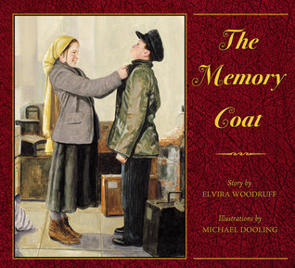
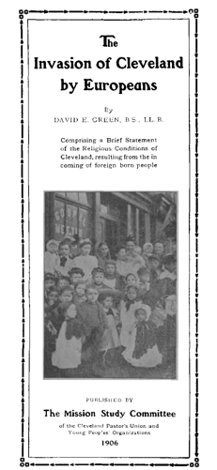
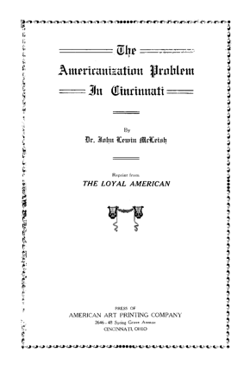
At the inspection station at Ellis Island, Russian emigre Rachel aids her cousin when an inspector singles him out for wearing an old tattered coat that could jeopardize his entrance into the new homeland.
The Memory Coat
Additional Resources about the European Experience in Ohio
Italian Ohioans
Irish Ohioans
German Ohioans
Click on Images to learn more

Slide 25
No Irish Need Apply: Advertisement from the Cleveland Daily Plain Dealer 1862
Click on the above images to learn more.
A group of youthful St. Demetrios dancers in native Greek costumes includes Emily Pamphilis, Dina Mihalis, Manuel Kamkutis, Tom Parras and Toni Kakludis.
Black and white photograph of Mama Maria and her granddaughter. "The queen of Guarino's Restaurant in "Little Italy"--Mama Maria--shows her little granddaughter and namesake just how homemade spaghetti should look". 1958-09-09
Gustav Herman Otto Labinski on the beach with his grandson Charles Gustav Willhelm Braun, Cleveland, Ohio, ca. 1915.

Slide 26
Featured Voices from the Asian Community
Give the ones you love wings to fly, roots to come back, and reasons to stay.- Dalai Lama
Over Twenty countries participate in the Annual Asian Festival that is one of the largest and vibrant festivals of the year. This set of resources is a representation of the varied experiences and cultures found in this community. Immigration is part of the narrative along with identity, family and finding one’s place.
Drawn from author Kao Kalia Yang's childhood experiences as a Hmong refugee, this moving picture book portrays a family with a great deal of love and little money. Weaving together Kalia's story with that of her beloved grandmother, the book moves from the jungles of Laos to the family's early years in the United States.
The Most Beautiful Thing Read Aloud
"The Shared Room" by Kao Kalia Yang - 2020 MN Children's Book Festival

Slide 27
Caren Stelson brings Sachiko Yasui's story of surviving the atomic bombing of Nagasaki and her message of peace to a young audience.
Sachiko's family home was about half a mile from where the atomic bomb fell on August 9, 1945. When they returned to the rubble where their home once stood, her father miraculously found their serving bowl fully intact. This delicate, green, leaf-shaped bowl--which once held their daily meals--now holds memories of the past and serves as a vessel of hope, peace, and new traditions for Sachiko and the surviving members of her family.
"A Bowl Full of Peace" by Caren Stelson - 2020 MN Children's Book Festival
Every day, Rupa's grandmother wears a beautiful Indian sari.
Kashmira Sheth provides young readers with a unique view of Indian culture and tradition through this affectionate, sensitive portrait of a grandmother and her American granddaughter. Hindu words defined and sprinkled throughout the text further add to the authenticity of the story.
My Dadima Wears a Sari. Read aloud. Beautiful Indian tradition and culture across generations.
As a young boy, Bao Phi awoke early, hours before his father's long workday began, to fish on the shores of a small pond in Minneapolis. Unlike many other anglers, Bao and his father fished for food, not recreation. A successful catch meant a fed family. Between hope-filled casts, Bao's father told him about a different pond in their homeland of Vietnam.
A Different Pond Read-Aloud

Slide 28
A young Asian girl notices that her eyes look different from her peers'. She realizes that her eyes are like her mother’s, her grandmother's, and her little sister's. They have eyes that kiss in the corners and glow like warm tea, crinkle into crescent moons, and are filled with stories of the past and hope for the future. Drawing from the strength of these powerful women in her life, she recognizes her own beauty and discovers a path to self love and empowerment.
#BNStorytime: Joanna Ho reads EYES THAT KISS IN THE CORNERS
A joyful, body-positive picture book about a young Indian American girl's journey to accept her body hair and celebrate her heritage after being teased about her mustache. With her parents' help, Laxmi learns that hair isn't just for heads, but that it grows everywhere, regardless of gender. Featuring affirming text by Shelly Anand and exuberant, endearing illustrations by Nabi H. Ali.
Laxmi's Mooch by Shelly Anand - Read Aloud Picture Book | Brightly Storytime
Additional Resources about the Asian Experience in Ohio
Ohio Asian Americans- Report prepared by the Ohio Department of development
https://www.aacsohio.org/- Ohio Asian American Community Services
https://clevelandmemory.contentdm.oclc.org/digital/collection/press/search/searchterm/Chinese- Cleveland Memory collection of photographs and documents of Chinese Ohioans.
https://clevelandmemory.contentdm.oclc.org/digital/collection/press/search/searchterm/Japanese-Cleveland Memory collection of photographs and documents of Japanese Ohioans.
https://www.ohiomemory.org/digital/collection/p16007coll33/search/searchterm/aSIAN

Slide 29
A black and white snapshot of the 200 block of Summit Street in downtown Toledo, Ohio. The photo includes the Toledo Trust Building, the Summit Parking Garage and the Holiday Inn hotel. The Summit Parking Garage is now home to the Balance Pan Asian Grille and urban farm, Photo was taken by Howard Mackenzie in September of 1974.
''On Leong officials ... Louis Woo, Cleveland president ... Yee Kins Lai of Pittsburgh, natl president ... George Mook, Boston, natl president ... Woo Sing, Cleveland president''
''Alvin and Helen Wong students at Peter Wong's school 1293 Ontario St. ... Chinatown''
Cathy Hizaki playing the Koto, a traditional Japanese musical instrument at Warden Road Elementary in Wickliffe, Ohio. ''Cathy Hizaki; Sandra Hatcher, Bob Donner, Bob; Jones, Thomas Gorensek Warden Road Elementary School, Wickliffe''

Slide 30
Featured Voices from the Arab American Community
We must learn to live together as brothers or perish together as fools.- Martin Luther King Jr
This set of resources illuminates the perseverance and tenacity often found in this community that has not always made the decision to leave home but has had that decision made for them. These resources speak as much to decision to leave as it is to the decision to start a new.
Since 2006, hundreds of thousands of Iraqi refugees have fled to other countries—particularly neighboring Syria and Jordan—where many of them are still waiting for the time when they feel it is safe to return home. This book provides, in words and pictures, what life was like in Iraq before they left, why they were forced to flee, and how they feel about life as a refugee. Their stories are set against background information about Iraq, Saddam Hussein's rule, the invasion, and the subsequent civil war.

Slide 31
Stepping Stones tells the story of Rama and her family, who are forced to flee their once-peaceful village to escape the ravages of the civil war raging ever closer to their home. With only what they can carry on their backs, Rama and her mother, father, grandfather and brother, Sami, set out to walk to freedom in Europe. Nizar Ali Badr's stunning stone images illustrate the story.
Margriet Ruurs reads Stepping Stones: A Refugee Family's Journey
That night, Kanzi wraps herself in the beautiful Arabic quilt her teita (grandma) in Cairo gave her and writes a poem in Arabic about the quilt. Next day her teacher sees the poem and gets the entire class excited about creating a “quilt” (a paper collage) of student names in Arabic. In the end, Kanzi’s most treasured reminder of her old home provides a pathway for acceptance in her new one.
The Arabic Quilt
A Lebanese boy named Luli describes life in his seaside home, where he revels in the company of three cats—the Lucys of the title. Based on the author's experience during the conflict between Hezbollah and Israel in 2006. The bombs force Luli and his parents to return to Beirut, where they stay with their relatives for weeks, The disappearance of one of the Lucys and the evident destruction wrought by the bombing offer a somber, though not hopeless, entry point for discussions of loss and the consequences of war.
The Three Lucys BookTrailer

Slide 32
Grandma wears it clasped under her chin. Aunty pins hers up with a beautiful brooch. Jenna puts it under a sun hat when she hikes. Zara styles hers to match her outfit. As a young girl observes six very different women in her life who each wear the hijab in a unique way, she also dreams of the rich possibilities of her own future, and how she will express her own personality through her hijab.
Under my Hijab
Additional Resources about the Arab American Experience in Ohio
Click on the above images to learn more.
Ohio — Yalla Count Me In!- Yalla Count Me In! is a national, grassroots coalition-led movement to Get Out The Count (GOTC) of Arab Americans for the 2020 Census
Arab Americans of Central Ohio - Home
Arab Americans in Central Ohio: Negotiating Cultural Identities and Adapting Traditions. An Oral History Project. · Arab-American Project

Slide 33
Featured Voices from the African Community
Diversity is about all of us, and about having to figure out how to walk through this world together. - Jacqueline Woodson
This set of resources speak to the most recent and one of the fastest growing communities in Ohio. It like many of the other groups is highly diverse but has commonalities among themselves as well as to other communities that have come as immigrants and refugees. One unique aspect of this set is the inclusion of author Oge Mora who parents immigrated from Nigeria to Columbus, Ohio.
In this heartfelt and universal story, a mother and daughter look forward to their special Saturday routine together every single week. But this Saturday, one thing after another goes wrong–ruining storytime, salon time, picnic time, and the puppet show they’d been looking forward to going to all week. Mom is nearing a meltdown…until her loving daughter reminds her that being together is the most important thing of all.
Saturdays
2020 BGHB interview with Picture Book winner Oge Mora

Slide 34
Watch Me is based on the author's father's own story. Joe came to America from Africa when he was young. He worked hard in school, made friends, and embraced his new home. Like so many immigrants before and after him, Joe succeeded when many thought he would fail.
Watch Me
Of all her friends, Abia has been at the Shimelba Refugee Camp the longest—seven years, four months, and sixteen days. Papa says that’s too long and they need a forever home. Until then, though, Abia has something important to do. Be a queen. And sometimes, when Papa talks hopefully of their future, forever home, Abia is a little nervous. Forever homes are in strange and faraway places—will she still be a queen?
https://vimeo.com/434893611
Tani was just six years old when he and his family fled persecution in Nigeria and became refugees in New York City. Tani was amazed, and a little overwhelmed, by all the new things in America. With joy and determination, Tani studied hard, practicing chess for hours on the floor of his room in the homeless shelter. Less than a year later, he won the New York State Chess Championship, and through one act of kindness after another, found a new home.

Slide 35
Young Roblay runs through his Somali village practicing for the big race, where only the fastest runners will be declared men. He turns for advice to his grandfather, who tells Roblay of the mighty Shabelle River, which is strong and swift like a cheetah. Inspired by her father's storytelling, Khadra Mohammed joins Karen Lynn Williams in retelling this Somali coming-of-age tale. The story of a proud people who once lived together peacefully and drew wisdom from the animals.
The Spirit of the Cheetah
Additional Resources about the African Experience in Ohio
Ohio's African immigrant community growing in size, diversity and impact
New African Immigrants Commission New African Immigrants Commission New African Immigrants Commission New African Immigrants Com

Slide 36
Intersecting Themes and Cultures
The ache for home lives in all of us. The safe place where we can go as we are and not be questioned. - Maya Angelou
This set of resources highlights the intersection of different cultural groups that ultimately form bonds that allow for the formation of communities. The themes of hair, name (identity),family/ ancestry, bicultural and biethnic, and immigration are explored.
The barbershop is where the magic happens. Boys go in as lumps of clay and, with princely robes draped around their shoulders, a dab of cool shaving cream on their foreheads, and a slow, steady cut, they become royalty. That crisp yet subtle line makes boys sharper, more visible, more aware of every great thing that could happen to them when they look good: lesser grades turn into As; girls take notice; even a mother's hug gets a little tighter. Everyone notices.
A fresh cut makes boys fly.
Caleb McLaughlin Reads "Crown: An Ode to the Fresh Cut" | Bookmarks | Netflix Jr

Slide 37
La abuela Petronila demuestra todo el amor que siente por su nieta, al contarle historias familiares. También brinda lecciones sobre la defensa del cabello natural. Este es un cuento que resalta las raíces de la afro puertorriqueñidad y que infunde orgullo para que crezca la autoestima en nuestros nietos y nietas, hijos e hijas.
Lectura: Pelo Bueno de Yolanda Arroyo Pizarro
A Sikh father and daughter with a special hair bond proudly celebrate and share a family tradition. Some days he braids her hair in two twists down the side of her face. Other days he weaves it into one long braid hanging down her back, just like a unicorn tail.
But her favorite style is when he combs her hair in a tight bun on the top of her head, just like the joora he wears every day under his turban. They call this their hair twin look!
#BNStorytime: Raakhee Mirchandani reads HAIR TWINS
One night, while Dalia slept safely wrapped in her mother's cool silken sheets, her hair grew and grew. By the time the rooster crowed, her hair had "grown straight up to the sky, tall and thick as a Cuban royal palm tree." In this whimsical bilingual picture book, Dalia's hair becomes a magical force of nature, a life giving cocoon
.Author-illustrator Laura Lacamara reads her bilingual picture book DALIA'S WONDROUS HAIR

Slide 38
Zuri’s hair has a mind of its own. It kinks, coils, and curls every which way. Zuri knows it’s beautiful. When mommy does Zuri’s hair, she feels like a superhero. But when mommy is away, it’s up to daddy to step in! And even though daddy has a lot to learn, he LOVES his Zuri. And he’ll do anything to make her—and her hair—happy.
#BNStorytime for Father's Day: enjoy this reading of HAIR LOVE by Matthew Cherry!
Hair Love | Oscar®-Winning Short Film (Full) | Sony Pictures Animation
Frustrated by a day full of teachers and classmates mispronouncing her beautiful name, a little girl tells her mother she never wants to come back to school. In response, the girl's mother teaches her about the musicality of African, Asian, Black-American, Latinx, and Middle Eastern names. Empowered by this newfound understanding, the young girl is ready to return the next day to share her knowledge with her class. Your Name is a Song is a celebration to remind all of us about the beauty, history, and magic behind names.
Kids Read Aloud: Your Name is a Song📚
Being the new kid in school is hard enough, but what about when nobody can pronounce your name? Having just moved from Korea, Unhei is anxious that American kids will like her. So instead of introducing herself on the first day of school, she tells the class that she will choose a name by the following week. On the day of her name choosing, the name jar has mysteriously disappeared. Encouraged by her new friends, Unhei chooses her own Korean name and helps everyone pronounce it.
🌟The Name Jar -- read aloud

Slide 39
If you ask her, Alma Sofia Esperanza José Pura Candela has way too many names. How did such a small person wind up with such a large name? Alma turns to Daddy for an answer and learns of Sofia, the grandmother who loved books and flowers; Esperanza, the great-grandmother who longed to travel; José, the grandfather who was an artist; and other namesakes, too. As she hears the story of her name, Alma starts to think it might be a perfect fit after all — and realizes that she will one day have her own story to tell.
CML Presents: Alma and How She Got Her Name (Alma y Cómo Obtuvó su Nombre) by Juana Martinez-Neal
Interview with Juana Martinez-Neal, creator of Alma and How She Got Her Name
Juana Martinez-Neal Draws Alma
Sangoel is a refugee. Leaving behind his homeland of Sudan, where his father died in the war, he has little to call his own other than his name, a Dinka name handed down proudly from his father and grandfather before him. When Sangoel and his mother and sister arrive in the United States, everything seems very strange and unlike home. Sangoel quietly endures the fact that no one can pronounce his name. Lonely and homesick, he finally comes up with an ingenious solution to this problem, and in the process he at last begins to feel at home.
My Name is Sangoel
This remarkable book brings together fourteen outstanding artists from different communities to honor the ancestors who most touched their lives. Through stories, art, and photographs, it inspires children and their families to honor their own ancestors, so that we can gain strength from the past.

Slide 40
Two Mrs. Gibsons is author Toyomi Igus’s tender and touching tribute to the two most important women in her life, her Japanese mother and her African-American grandmother. In it, Toyomi celebrates the richness of growing up biracial. From her grandmother’s big bear hugs to her mother’s light caresses, from playing with her grandmother’s fancy Sunday-meetin’ hats to trying on her mother’s kimono, the author conveys the warmth of these special relationships.
Two Mrs Gibsons Read Aloud
Written as a letter from a father to his daughter, Yo Soy Muslim is a celebration of social harmony and multicultural identities. The vivid and elegant verse, accompanied by magical and vibrant illustrations, highlights the diversity of the Muslim community as well as Indigenous identity. A literary journey of discovery and wonder.
Yo Soy Muslim:A Father's Letter to His Daughter by Mark Gonzales READ ALOUD ~RING AROUND RONINA~
A powerful story about a simple question—WHERE ARE YOU FROM? When a young girl is asked where she’s from—where she’s really from—she’s no longer as sure as she was. She decides to turn to her dear abuelo for some help with this ever-persistent question. But he doesn’t quite give her the answer she expects.
WHERE ARE YOU FROM? | Storytime with Yamile Saied Méndez

Slide 41
While the nine young adults who tell their stories came to the United States from different countries, there are commonalities among them beyond the tenuous situations in which they still find themselves. Narratives detailing their experiences with Deferred Action for Childhood Arrivals, border security, and their feelings about assimilating into U.S. society while leaving behind their homelands. In order to protect the participants, they are identified only by first initials, empty frames have replaced photographs of them.
We Are Here to Stay: Voices of Undocumented Young Adults Book Trailer

Slide 42
Immigrants and Refugees Telling Their Stories, Both Then and Now
If you’re not writing your own story, you’re a character in someone else’s.— Chris Brogan
This set of resources embodies the spirit of the textset in that it allows the communities to speak for themselves. Some are echoes from the past and other speak to the future.
Click on the images below and to the right to learn more.
¡Dímelo, Columbus!
Latinos Speak
To Learn more about this project click here: https://medium.com/communityworksjournal/oral-history-in-the-digital-era-narratives-of-latin-s-in-ohio-1e842f7b14b9 To see oral histories click on image above.

Slide 43
Click on the images to learn about the organization and their projects

Slide 44
Resources about Columbus Neighborhoods Both Then and Now
No story lives unless someone wants to listen. The stories we love best do live in us forever. - J.K. Rowling
Get to know the neighborhoods by clicking on the image above and explore. Each neighborhood has videos, timelines, lessons and posts with interesting information. Use this toolkit to help guide you. https://columbusneighborhoods.org/wp-content/uploads/toolkit.pdf
https://en.wikipedia.org/wiki/Neighborhoods_in_Columbus,_Ohio

Slide 45
A neighborhood that only exists in the past...
Resources
http://columbusbicentennial.blogspot.com/2012/01/flytown-northwest-columbus.html
https://www.youtube.com/watch?v=hGLcB8zuFTY
https://youtu.be/HYz6FKbkQRs
An industrial boom happened in Flytown during the 1870s and continued through the 1920s, as cheap land attracted foundries, lumberyards, and railroads to the area. As European immigrants and African American migrants from the south settled in the area, Flytown became one of the most diverse portions of Columbus

Slide 46
a neighborhood with two names...
https://www.columbusmonthly.com/story/lifestyle/features/2021/06/02/the-future-king-lincoln-bronzeville/7506907002/
https://www.10tv.com/article/news/local/bronzeville-community-a-historic-black-columbus-neighborhood-being-rebuilt/530-8582da50-944c-4692-bd78-e22cd1ec6c8c
https://www.dispatch.com/story/news/local/2020/12/12/lincolns-visage-doesnt-belong-near-east-side-mural-some-say/6462625002/
https://www.experiencecolumbus.com/blog/post/live-to-explore-bronzeville-with-willis-brown/
https://cpb-us-w2.wpmucdn.com/u.osu.edu/dist/1/3078/files/2012/06/Beth-Jax.pdf
“King-Lincoln-Bronzeville - Mt. Vernon Ave. Marker,” Teaching Columbus Historic Places, accessed July 19, 2021

Slide 47
and neighborhood worth preserving.
Who lives in Hanford Village?
https://teachingcolumbus.omeka.net/items/browse?collection=30
Click on the images below and to the right to learn more.

